Slide 1
New Space : How innovation initiatives change in Big Science
STP510 Yunji Woo

Slide 2
How Big Science formulated
Large scale projects usually funded by national government or group of governments
Big budget
Big staff
Big machines
Big laboratories
Centralization of scientific research as a cost-effective strategy
The outcome is unpredictable and underappreciated
High-technology warfare supports on scientific research
Importance of national security priority, big science research has developed with geo-political approaches

Slide 3
Big Firm Innovation
Static perspective
Large companies invest more in R&D and innovation
Dynamic perspective
Small enterprises can develop capabilities that improve R&D effectiveness through innovation, possibly even outperforming large enterprises
The relationship between the company size and R&D results is not linear, and can even be inverted
Cohen and Klepper, 1996; Becheikh, Landry and Amara, 2006; Stock, Greis and Fischer 2002

Slide 4

New Space Innovation?
Transition from Old space to New space
Commercial launches, Small satellite constellation
Technology development leads innovation in space
Reusable rocket
3D printed structure
6G Communication network using satellites
Socio-economic background
Commercial Data share to exceed Geo-political approach
Increase on international knowledge share

Slide 5
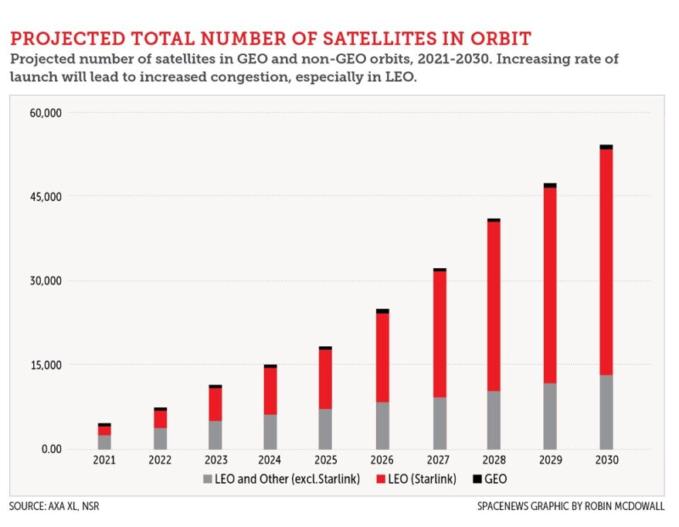
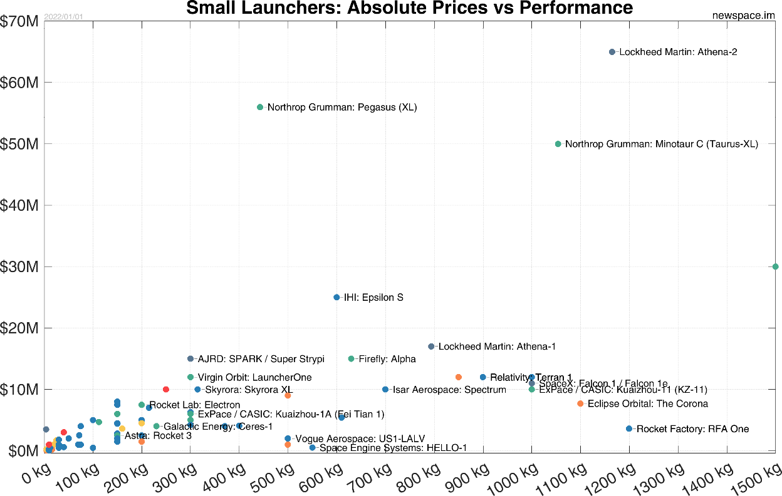
New Space Innovation?
Satellites in Orbit
Small Launchers prices

Slide 6
New Space Innovation?
Commercial success on space entrepreneurs
Space industry is being lead by start-ups
Upstream start up
Develop satellite, launcher, ground systems
Downstream start ups
Satellite information application and scientific research

Slide 7
Research Question1.
Research Question 2.
Does change of initiatives, government centric to commercial firm, provoke rapid innovation especially on space sector?
What would be the role of policy in big science and emerging technology?

Slide 8
Innovation Theory
Technological Innovation
Promising vehicle for continued wealth creation & Sustainable competitive advantage
Process of technological change in a free market consists of three parts
Invention (conceiving a new idea or process)
Innovation (arranging the economic requirements for implementing an invention)
Diffusion (whereby people observing the new discovery adopt or imitate it)

Slide 9
Innovation Theory
Sectoral systems of Innovation
Innovation
The process involving interactions of actors for generating and exchange of knowledge relevant to innovation and commercialization
Innovation systems
Different actors interacts to promote creation of technological innovations
Facilitates diffusion or applications of technological innovations
Sectoral innovation Systems
Innovation takes place in different sectoral environments
Focus on certain sectors of the economy
The strengthened supply chains and infrastructures could contribute on sectoral innovations, which would led regional innovation systems.

Slide 10
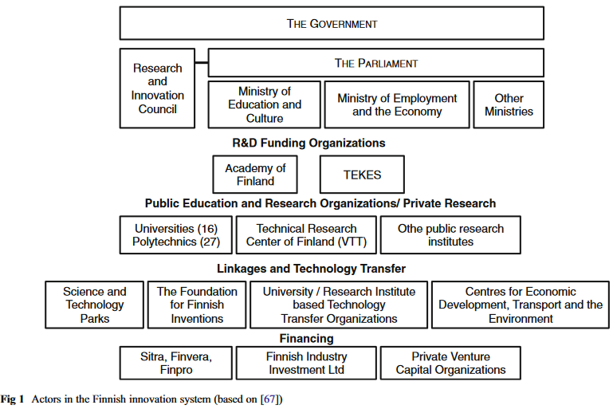
Recognition of Actors, Relationships and Networks
Propose dynamic view of innovation in sectors
Ref) Pihlajamaa, M. et al. (2013) ‘Requirements for innovation policy in emerging high-tech industries’, European Journal of Futures Research, 1(1), pp. 1–14.

Slide 11
Recognition of Actors, Relationships and Networks
1) Public Procurement: Government-Firm relationship
Upstream sectors usually provide public procurement.
The contracting authority bears the risks related to investments in research & development.
Risk can deter private companies from bearing innovation costs, which leads to a suboptimal level of innovation.
Government Agencies
Firms
Research Institutes
e.g) Universities

Slide 12
Recognition of Actors, Relationships and Networks
2) Research connection: Firm-University relationship
Academic research plays a key role in the industrial innovation process.
Government Agencies
Firms
Research Institutes
e.g) Universities

Slide 13
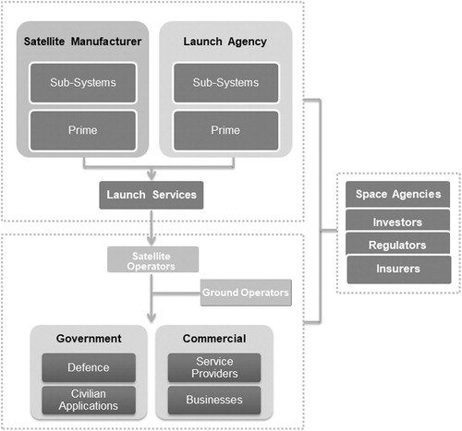
Satellite Value Chain
Upstream
Downstream
Instream
Ref) A Theoretical Assessment of Standardization
of the Satellite Upstream Value Chain
https://www.liebertpub.com/doi/full/10.1089/space.2020.0037

Slide 14
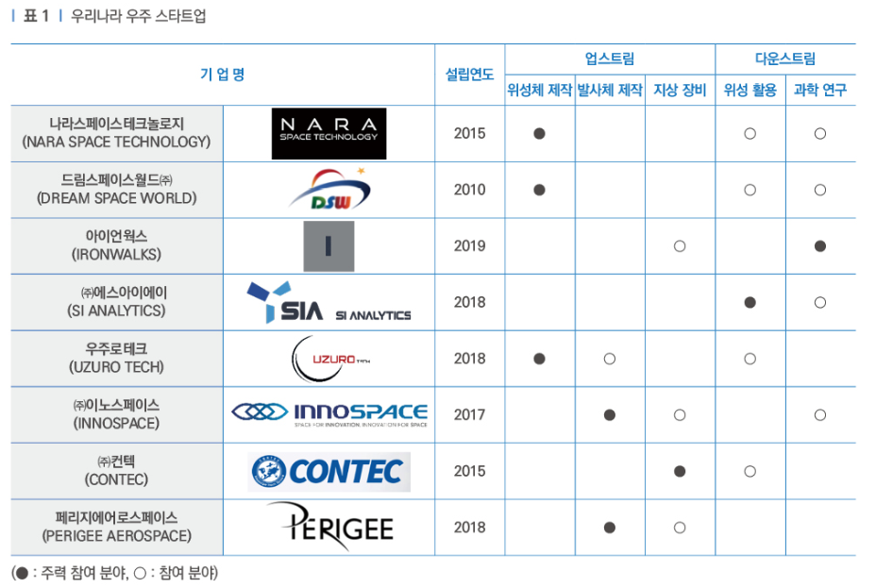
Case study of South Korea

Slide 15
Case study of South Korea
Research Methodology
Regional analysis: GIS analysis to investigate how enterprises are distributed
Network analysis: Social Network Analysis understand the transaction structure of the firm
Market analysis: Estimate the efficiency and productivity of space companies
Ref) STEPI(2019), 뉴스페이스(New Space) 시대, 국내우주산업 현황 진단과 정책대응

Slide 16
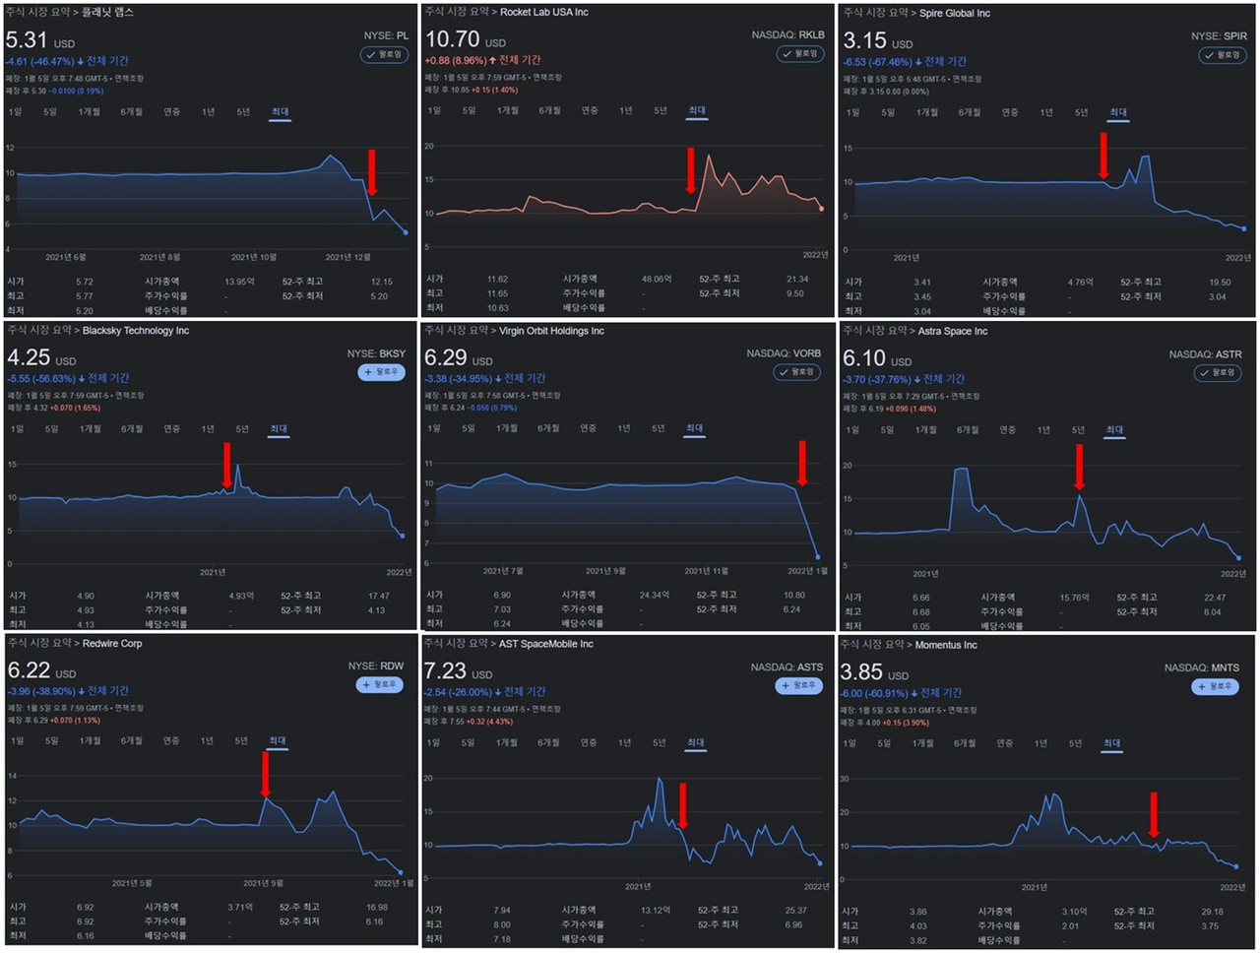
Technology innovation bubbles?
After M&A and stock listing, newspace companies’ value are falling sharply.
The financial structures of the US companies are revealed
Some companies did not meet customer requirements
Spire Global is operating 110 small satellite in space, but their market cap declined below investment
Ref) 헬로디디(22.07.20), 뉴스페이스, 광풍인가 vs 거품인가?

Slide 17
Policy Requests for Innovation
The implementation of innovation requires managers to confront and overcome barriers
Financial(cost, risk funding)
Organizational(rigidity, centralization)
Informational(market and technology information)

Slide 18
Policy Requests for Innovation
Enabling private individuals to take on greater risk that would be tolerable for government employed astronauts. Decentralized, market oriented space sectors
Judiciously implementing government regulation and support
Moving beyond geopolitical rivalries

